Slide 1
Feature Engineering and Importance
Starting with the features
By Susmit Vengurlekar

Slide 2
About Me
Dev Identity: susmitpy
Data Scientist | ML, DL with XAI | Cloud Architect (AWS) | End to End Software System Architect | Database Engineer | Backend Developer | Certified Neo4j Professional

Slide 3
Data Science
Input
Analysis and ML
Output
Garbage
Analysis and ML
Garbage

Slide 4
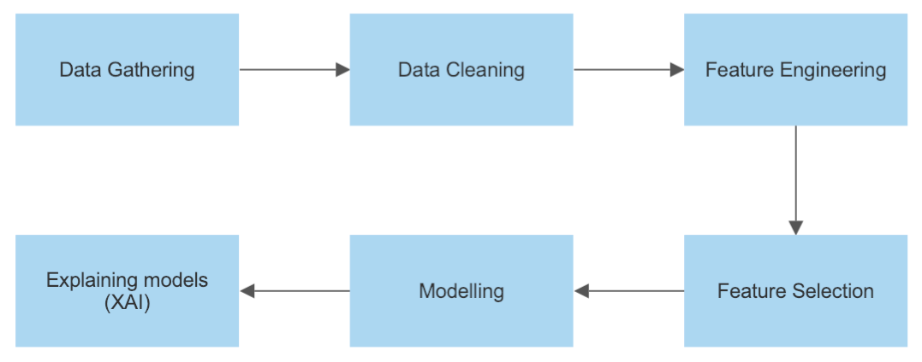
Usual Steps

Slide 5
Data Gathering
Flat Files - Excel, CSV, JSON, XML
IoT Data - Cassandra
Image Data - PNG, JPEG
RDBMS - SQL
Graph Data - Neo4J
Internet - Web scraping and crawling

Slide 6
Have you gathered / parsed correctly ?
Messy Dates
Different Date Formats
dd / mm / yyyy (eg. 15 / 01 / 2021)
mm / dd / yyyy (eg. 01 / 15 / 2021)
How will you ensure that you parse the dates correctly if you only have the data of first 12 dates of every month ?

Slide 7
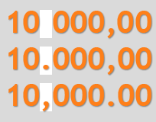
Have you gathered / parsed correctly ?
Messy Numbers
Thousands Separator vs Decimal Separator
Source: Wikipedia

Slide 8
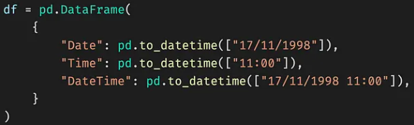
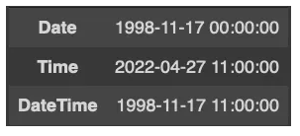
Have you gathered correctly ?

Slide 9
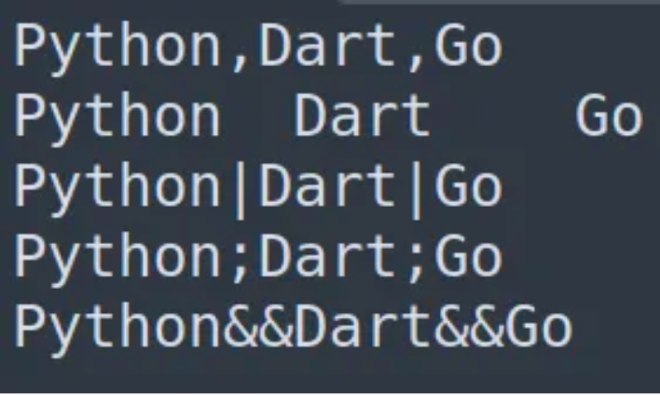
Have you gathered correctly ?
Parsing separated files
A new programming language named as C&& comes up as an alternative to C++

Slide 10
Data Cleaning
Handling Missing Values
Detecting and Handling Outliers
Duplicate Rows
Validation of Data

Slide 11
Feature Engineering
Imputing Null Values - As a new Category
Transforming Numerical Data
Transforming Categorical Data
Generating New Features
Standard
Domain Specific

Slide 12
Feature Selection using Feature Importance
Based on Statistics
Based on ML Models

Slide 13
Modelling
Type of Task
Choosing Metric
Supervised Learning
Classification
Regression
Unsupervised Learning
Clustering
Accuracy, Precision, Recall, F1 Score, AUC
MSE (L2), MAE (L1), RMSLE (penalize underestimate more)
Silhouette

Slide 14
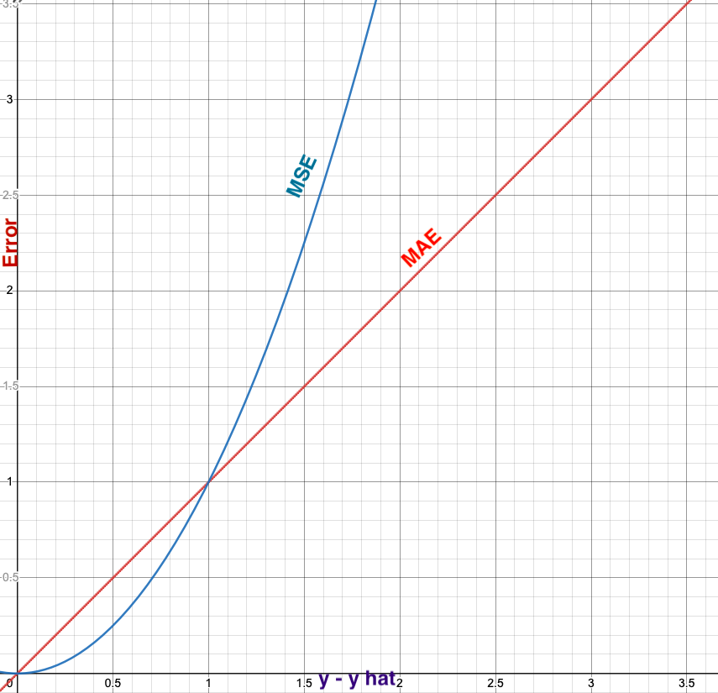
Regression Metrics
MAE vs MSE

Slide 15
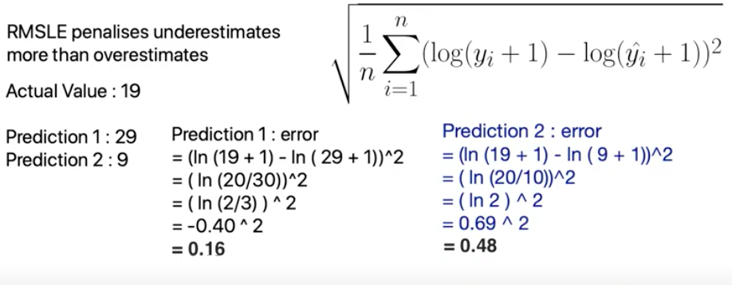
Regression Metrics
RMSLE

Slide 16
Modelling
Defining Model Zoo
Comparing models
Cross Validation
Hyper parameter tuning

Slide 17
Explainable AI (XAI)
SHAP
Uses the trained model to make predictions on varying data and checks how the model behaves
Final Prediction = Avg Prediction + shap value
LIME
Creates a new dataset containing varying data and predictions of model
Trains an interpretable model such as Linear Regression

Slide 18
Feature Engineering
TARGET LEAKAGE

Slide 19
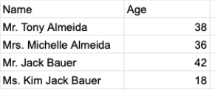
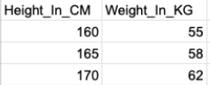
Feature Engineering Some Deep Thinking for Derived Features

Slide 20
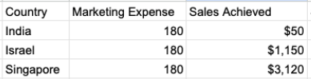
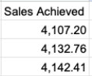
Feature Engineering Data Treatment

Slide 21
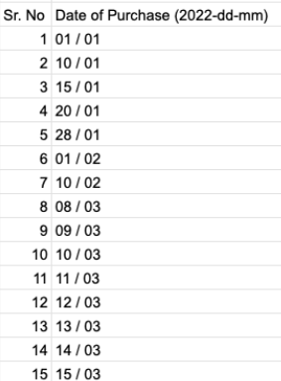
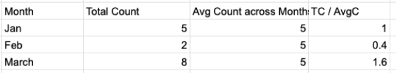
Feature Engineering Aggregation

Slide 22
Feature Engineering
Transforming Numerical Data
Binning
Cyclical Transformation
Log Transformation
Reciprocal Transformation
Polynomial Features
Feature Mixer

Slide 23
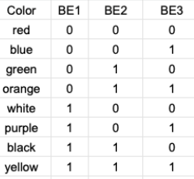
Feature Engineering
Transforming Categorical Data
Grouping
Ordinal Encoder (not Label Encoder !)
Count Encoder
Target Encoder / Leave One Out Encoder
CatBoost Encoder
One Hot Encoder
Binary Encoder

Slide 24
Feature Engineering
Encoding Date, Time and Date Times
Encoding Date - Difference between the date and earliest date
Encoding Time - Convert to 24 hour format and divide by 2359
Encoding DateTime - Difference between the datetime and earliest datetime

Slide 25
Feature Engineering
Generating New Features
Is Null
% Null Columns
Generating from Date
Day, Month, Year, Weekday, Quarter, Is Weekend
Generating from Time
Hour, Minute, Period

Slide 26
Feature Selection using Feature Importance
Based on Statistics
Correlation
Variance Thresholding

Slide 27
Feature Selection using Feature Importance
Based on ML Models
Feature Selection
Forward Selection
Backward Elimination
Feature Importance
Model Based - Lasso, Decision Tree
Permutation Importance

Slide 28

Enough talk, let’s write some code
http://bit.ly/3Mj2QyX

